Slide 1
Trading Distributions
June 8th 2016

Slide 2
Hypothesis
Hypothesis: High frequency trading is the reason for the large spike of transactions when the market closes
“HFTer’s have little to no overnight position”
“Assets suitable for HFT need to be very liquid”
Testing: Compare the distribution of trades to HFT prone assets (highly liquid), to not HFT prone assets.
Extension: Explore Firms that sell in that very last second.

Slide 3
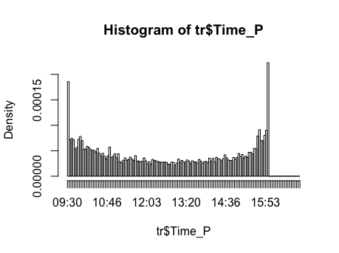
The U-Shape

Slide 4
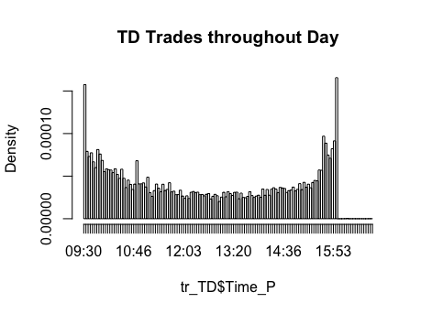
TD Firm

Slide 5
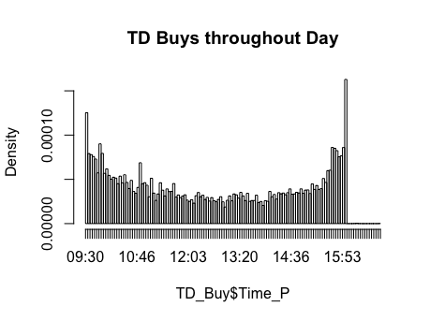
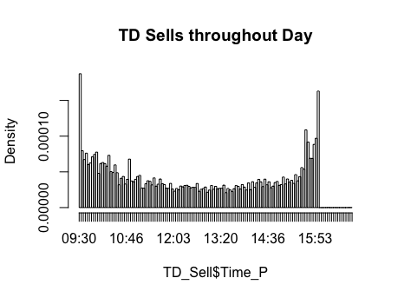
TD – Buys and Sells

Slide 6
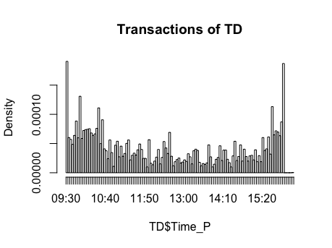
TD Stock – Transactions (3rd most traded)

Slide 7
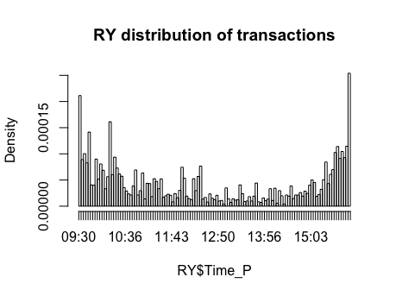
RY (2nd Most traded)

Slide 8
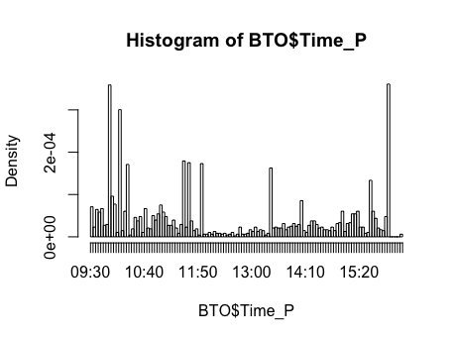
BTO – Transaction (74th most traded)

Slide 9
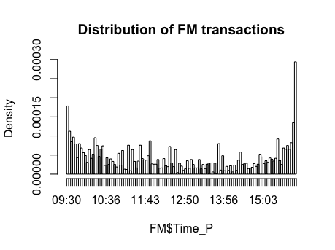
FM – Transactions (15th most traded)

Slide 10
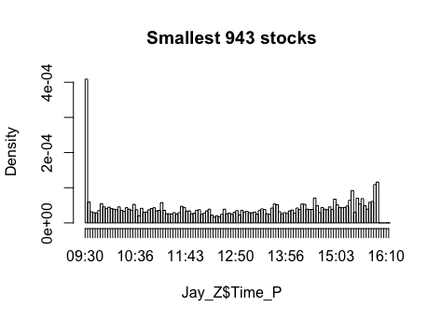
Bottom 50% traded stocks

Slide 11
Result
All the highly Liquid stocks have a noticeable jump right at the end of the day.
Although the small stocks have a small bump at the end of the day, it’s not nearly as aggressive as the jump for the more liquid stocks.
This supports the hypothesis that the tail at the end of the day is a result of high frequency trading.

Slide 12
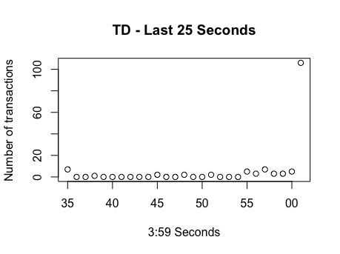
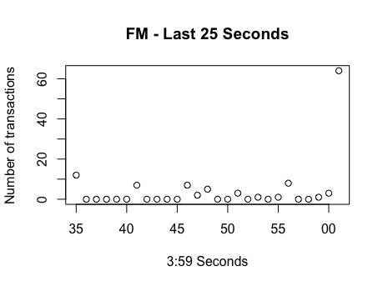
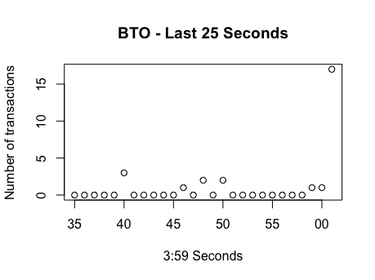
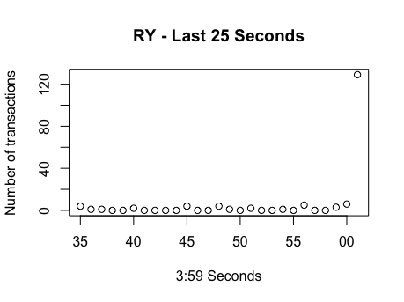
Last 25 second of trading: TD, BTO, FM, RY

Slide 13
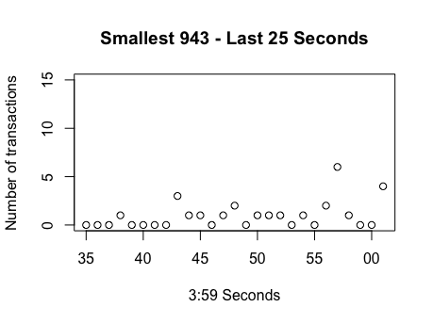
943 Smallest – Final 25 seconds

Slide 14
The Final 25 trading seconds: Results
The more liquid stocks demonstrate a clear jump at the very last second of trading
The smaller stocks demonstrate a bump which could only loosely be considered deviant.
Result: In the final second, more liquid stocks see an enormous amount of activity. This supports the hypothesis that the tail is caused by HFT, as it is shown most prominently on stocks that are appealing to high-frequency traders.

Slide 15
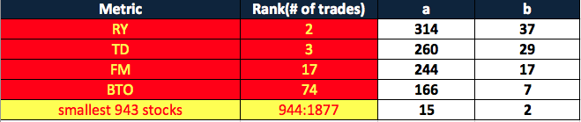
Numbers: Day 1
Result: The more liquid the stock (and thus vulnerable to HFT), the greater the effect of last second trading.

Slide 16
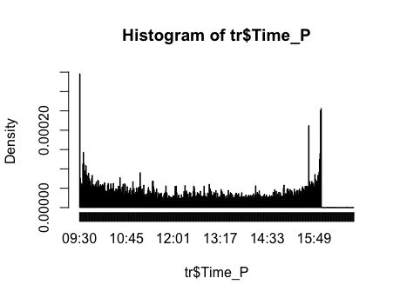
Day 2: Total Stocks

Slide 17
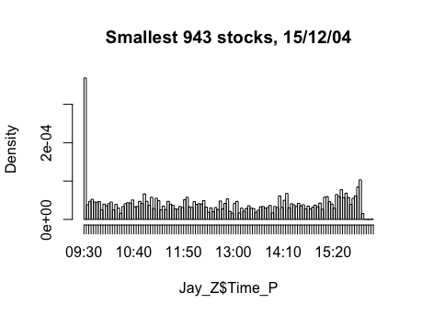
Small Stocks

Slide 18
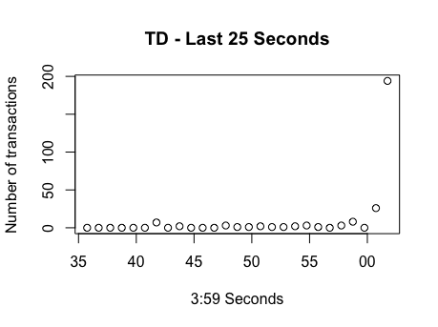
TD Stock – Day 2 checked

Slide 19
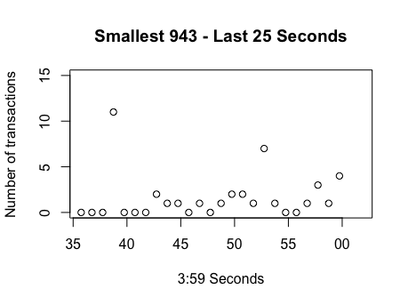
Smallest Stocks – Final 25 seconds (Day 2)

Slide 20
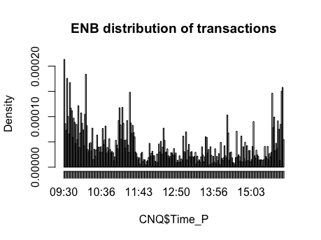
CNQ (most traded) - Hist

Slide 21
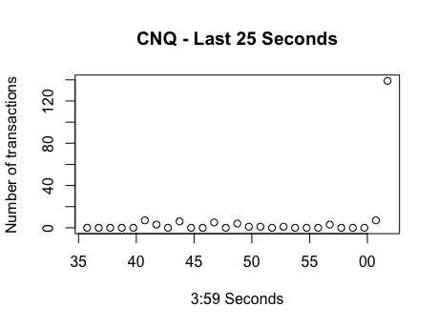
CNQ – Last 25 Seconds

Slide 22
Firms
53 Total Firms traded in the past second over 9 days of trading.
Summary of frequency over the 9 days:
Min. 1st Qu. Median Mean 3rd Qu. Max.
1.000 2.000 7.000 5.208 8.000 9.000

Slide 23
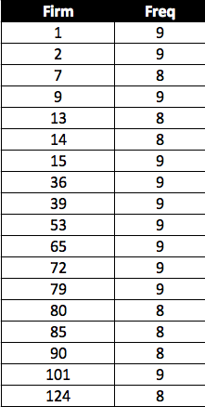
A look at the big Suspects:
18 Firms traded in the last second on 8 or more of these days.

Slide 24
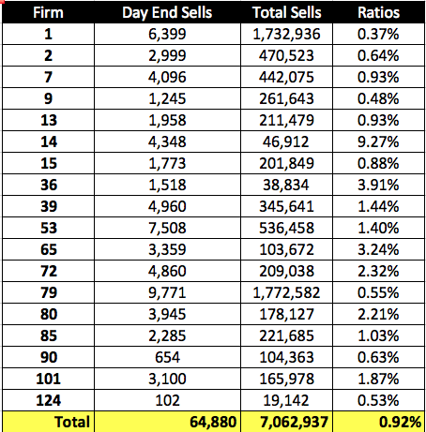
Numbers: on Firms
Note: If Selling were uniformly distributed, then we’d expect to see ~300 trades in any given second.
Expected Ratio is: 0.0042%
We are 216 times that

Slide 25
Summary of Ratios
Min. 1st Qu. Median Mean 3rd Qu. Max.
0.003693 0.006293 0.009786 0.018120 0.021280 0.092680
Expected ratio is: 0.000042
Even the smallest ratio of total sells in last second to total sells is 87 times that of the expected ratio (ratio if distribution were symmetric).
Notes:
Turn Summary into chart

